Slide 1
Supervised Models​ Part 2
Dr. Nassim Sohaee

Slide 2

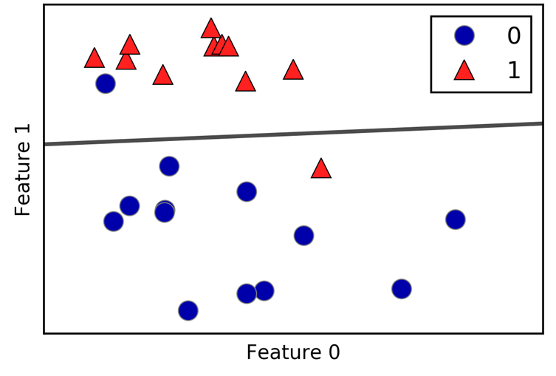
Linear Models for Classification

Slide 3
Linear Models for Classifications
The way in which they measure how well a particular combination of coefficients and intercept fits the training data
If and what kind of regularization they use

Slide 4
Estimating Probabilities
In logistic regression, we are only concerned about the probability of outcome dependent variable ( success or failure).
This function is established using two things: Probability of Success(p) and Probability of Failure(1-p). p should meet following criteria:
It must always be positive (since p >= 0)
It must always be less than equals to 1 (since p <= 1)

Slide 5
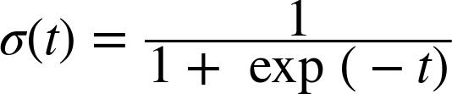
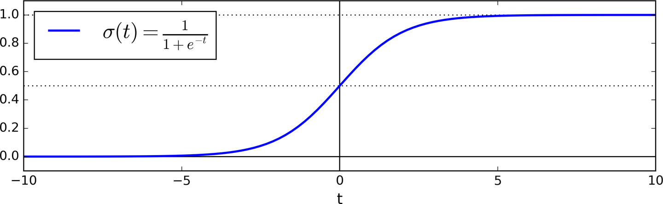
Logit Function
Logit function is a sigmoid function that returns the result between 0 and 1.

Slide 6
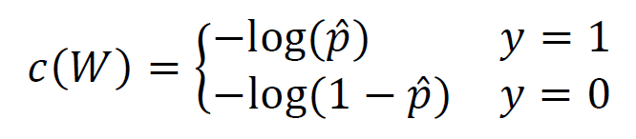
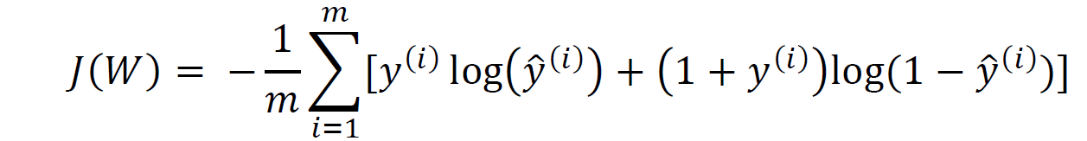
Training and Cost function
Cost function:
The cost function over the whole triaging set:

Slide 7
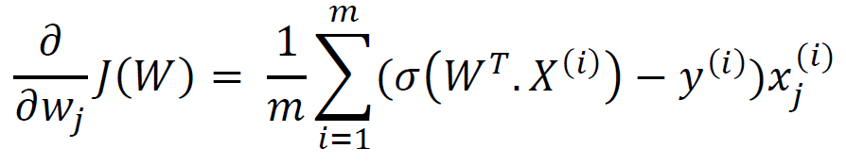
Minimizing Cost Function

Slide 8
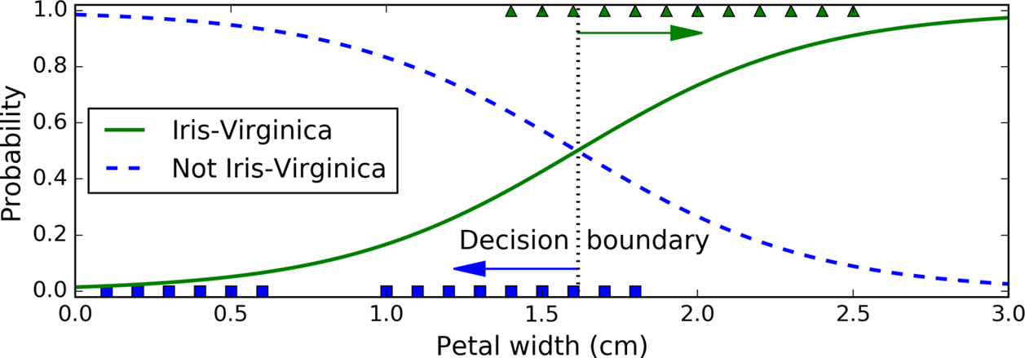
Decision Boundary

Slide 9
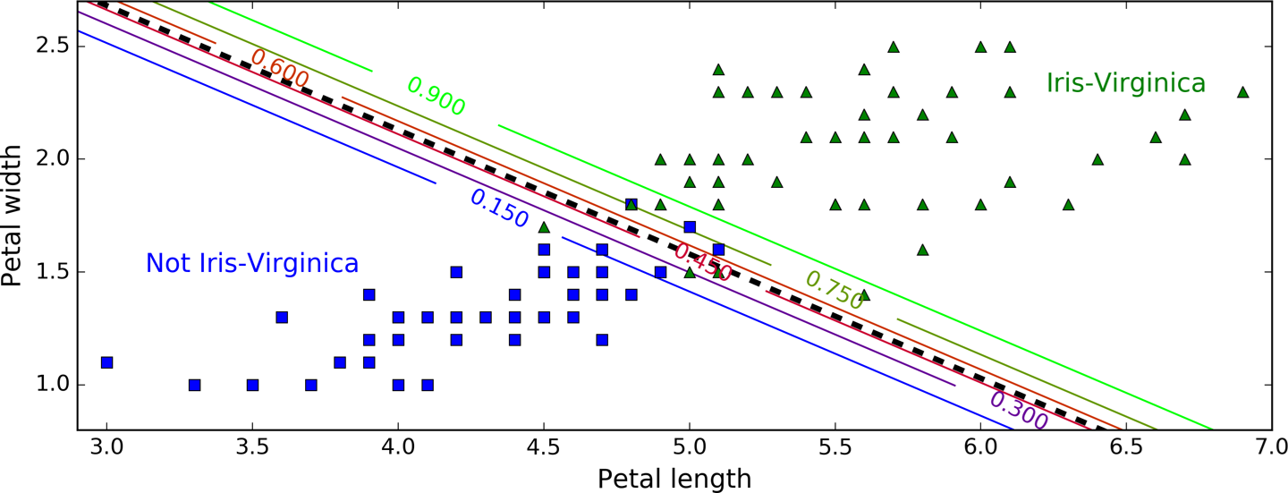
Decision Boundary

Slide 10
Regularization
Penalty
C

Slide 11

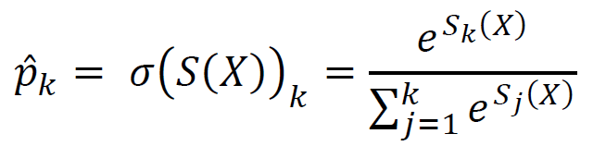
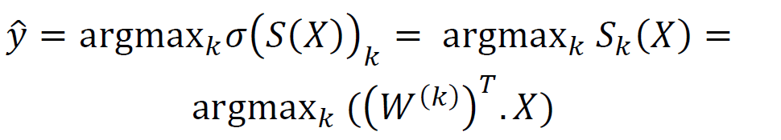
Softmax Regression
Generalization of Logistic regression

Slide 12
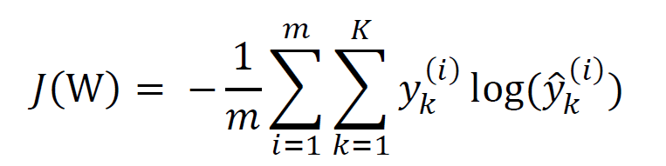
Cost function
Softmax regression classifier predicts only one class at a time
Objective:
Estimate the high probability for the target class

Slide 13
Cross Entropy
Cross entropy originated from information theory.
measures the average number of bits needed to identify an event drawn from the set of events.

Slide 14
Cross Entropy – Example
Efficiently transmit information about the weather every day.
There are eight options:
Sunny
Rain
Storm
Partly Cloudy
Overcast
Shower
Fog
Windy
000
001
010
011
100
101
110
111
0
1001
1010
1011
1100
1101
1110
1111

Slide 15
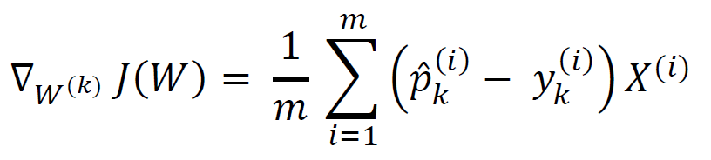
Cross Entropy

Slide 16
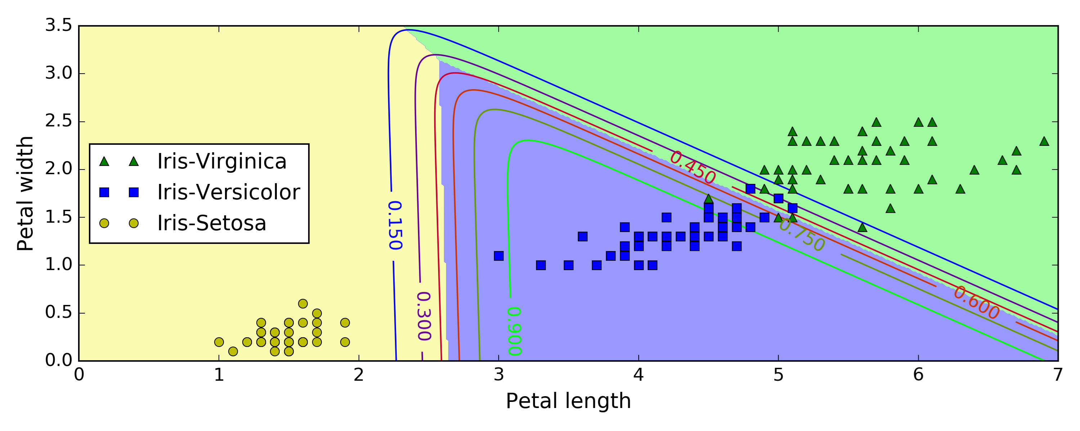
Softmax Decision Boundary

Slide 17
Support Vector Machines

Slide 18
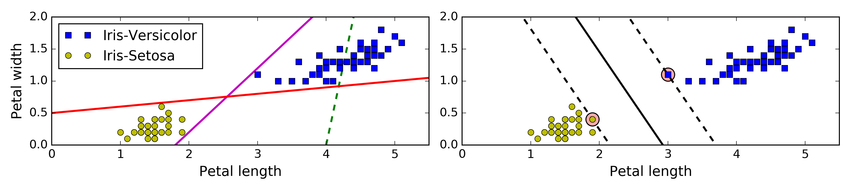
Linear SVM classification

Slide 19
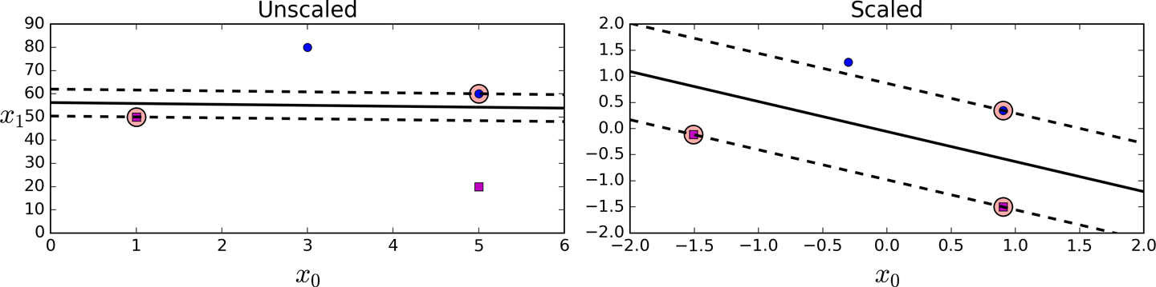
SVM

Slide 20
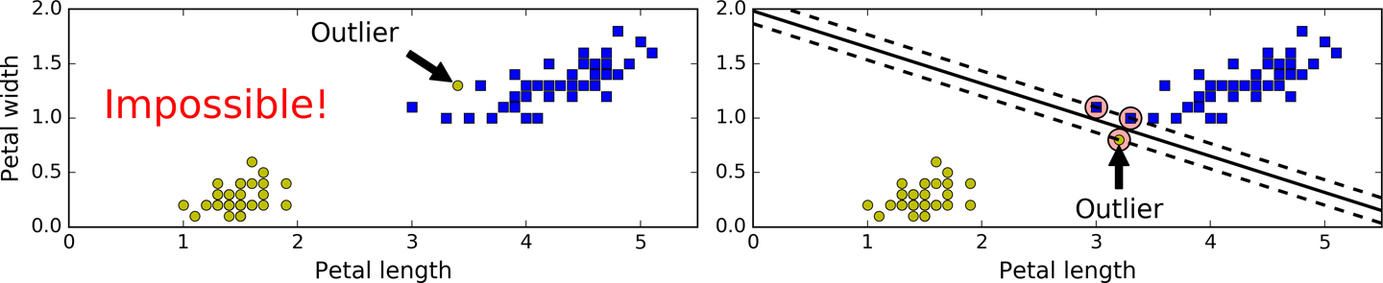
Soft Margin Classification
Hard Margin: If all the instances should be on the right side of the street.

Slide 21
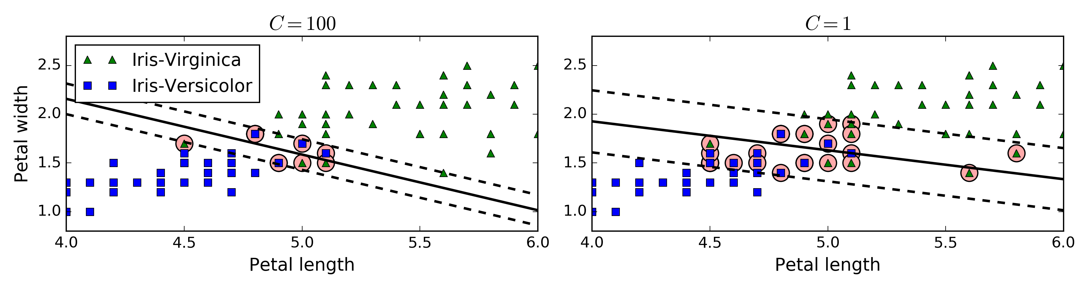
Soft Margin Classification

Slide 22

Linearly separable data
$$W^{T}X+b=0$$
Support Vector

Slide 23
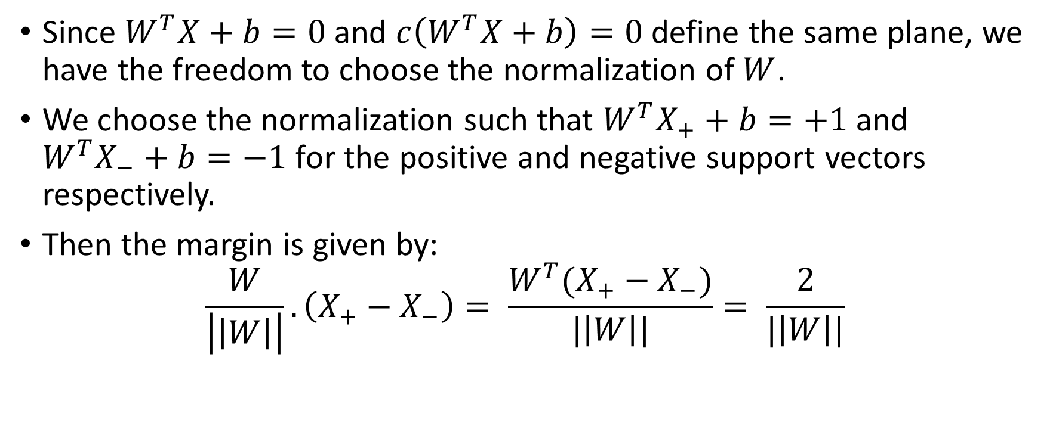
Support Vector
Since $W^{T}X+b=0$ and $c\left(W^{T}X+b\right)=0$ define the same plane, we have the freedom to choose the normalization of $W$.
We choose the normalization such that $W^{T}X_{+}+b=+1$ and $W^{T}X_{−}+b=−1$ for the positive and negative support vectors respectively.
Then the margin is given by:
$$\frac{W}{\left|\left|W\right|\right|}.\left(X_{+}−X_{−}\right)= \frac{W^{T}(X_{+}−X_{−})}{|\left|W\right||}= \frac{2}{|\left|W\right||}$$

Slide 24




Linearly separable data
$$W^{T}X+b=1$$
$$W^{T}X+b=0$$
$$W^{T}X+b=−1$$
Margin = $\frac{2}{|\left|W\right||}$

Slide 25

SVM - Optimization
Learning SVM can be formulated as an optimization problem:
$$\max_{W}{\frac{2}{|\left|W\right||}}$$
$$\text{Subject} \text{to} W^{T}X_{i}+b \left\{\begin{matrix}≥1 & y_{i}= +1 \\ ≤−1 & y_{i}=−1\end{matrix}\right.$$
$$\text{for} i=1, …, n$$

Slide 26
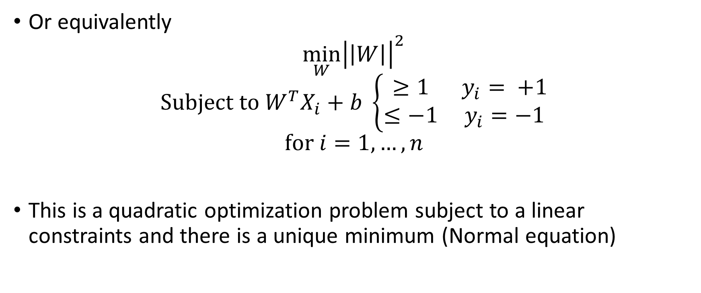
SVM - Optimization
Or equivalently
$$\min_{W}{{\left|\left|W\right|\right|}^{2}}$$
$$\text{Subject} \text{to} W^{T}X_{i}+b \left\{\begin{matrix}≥1 & y_{i}= +1 \\ ≤−1 & y_{i}=−1\end{matrix}\right.$$
$$\text{for} i=1, …, n$$
This is a quadratic optimization problem subject to a linear constraints and there is a unique minimum (Normal equation)

Slide 27
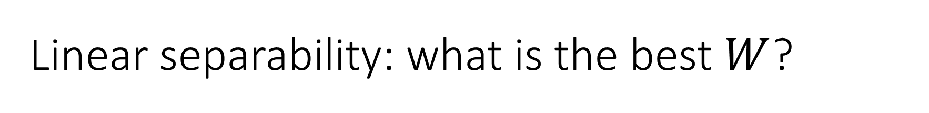
Linear separability: what is the best $W$?
The points can be linearly separable but there is a very narrow margin
But possibly the large margin solution is better, even though one constraint is violated.

Slide 28
Linear separability: what is the best $W$?
In general there is a trade off between the margin and the number of mistakes on the training data.

Slide 29
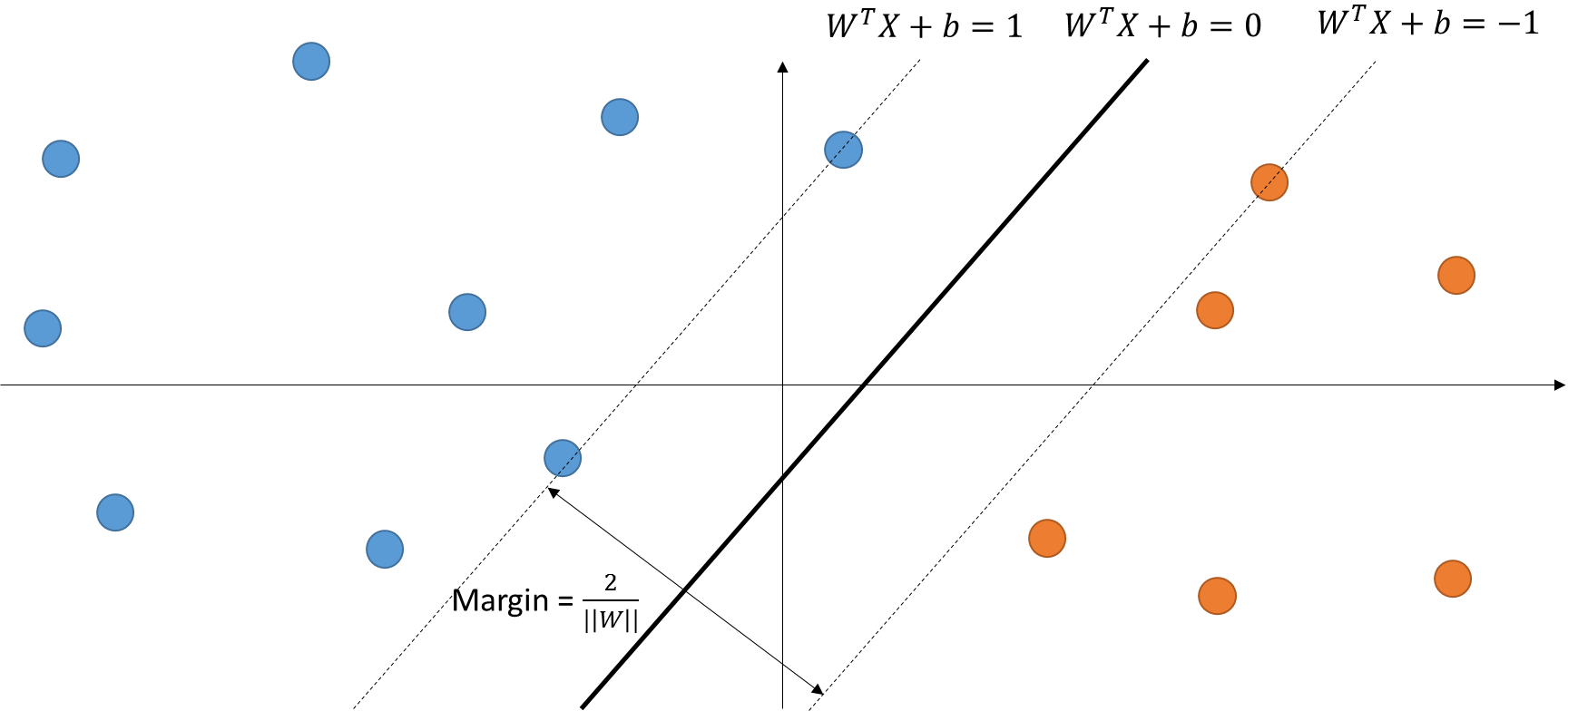
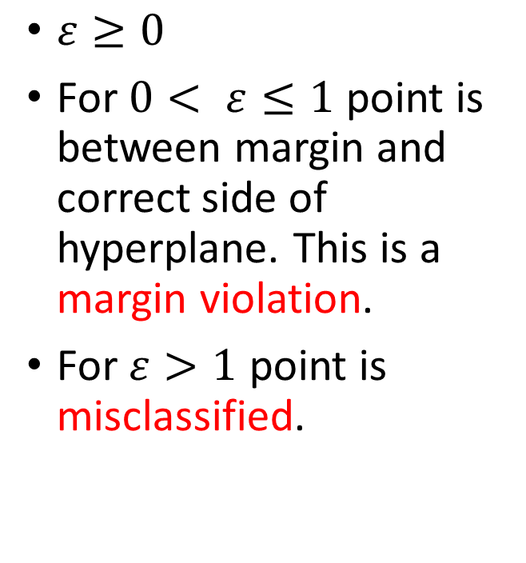
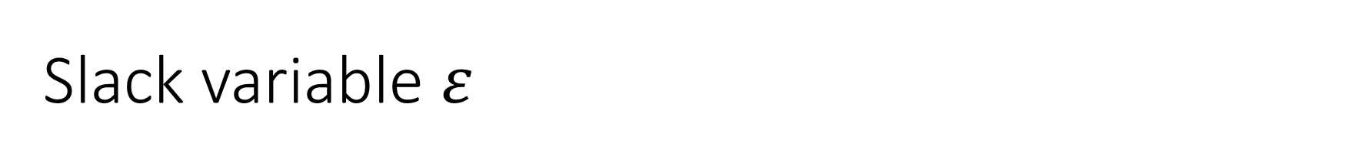
Slack variable $ε$
$ε≥0$
For $0< ε≤1$ point is between margin and correct side of hyperplane. This is a margin violation.
For $ε>1$ point is misclassified.

Slide 30

Soft Margin solution
The optimization problem becomes:
$$\min_{W, ε}{{\left|\left|W\right|\right|}^{2}+C\sum_{i=1}^{n}{ε_{i}}}$$
$$\text{Subject} \text{to} y_{i}\left(W^{T}X_{i}+b\right)≥1 − ε_{i}$$
$$\text{for} i=1, …, n$$

Slide 31
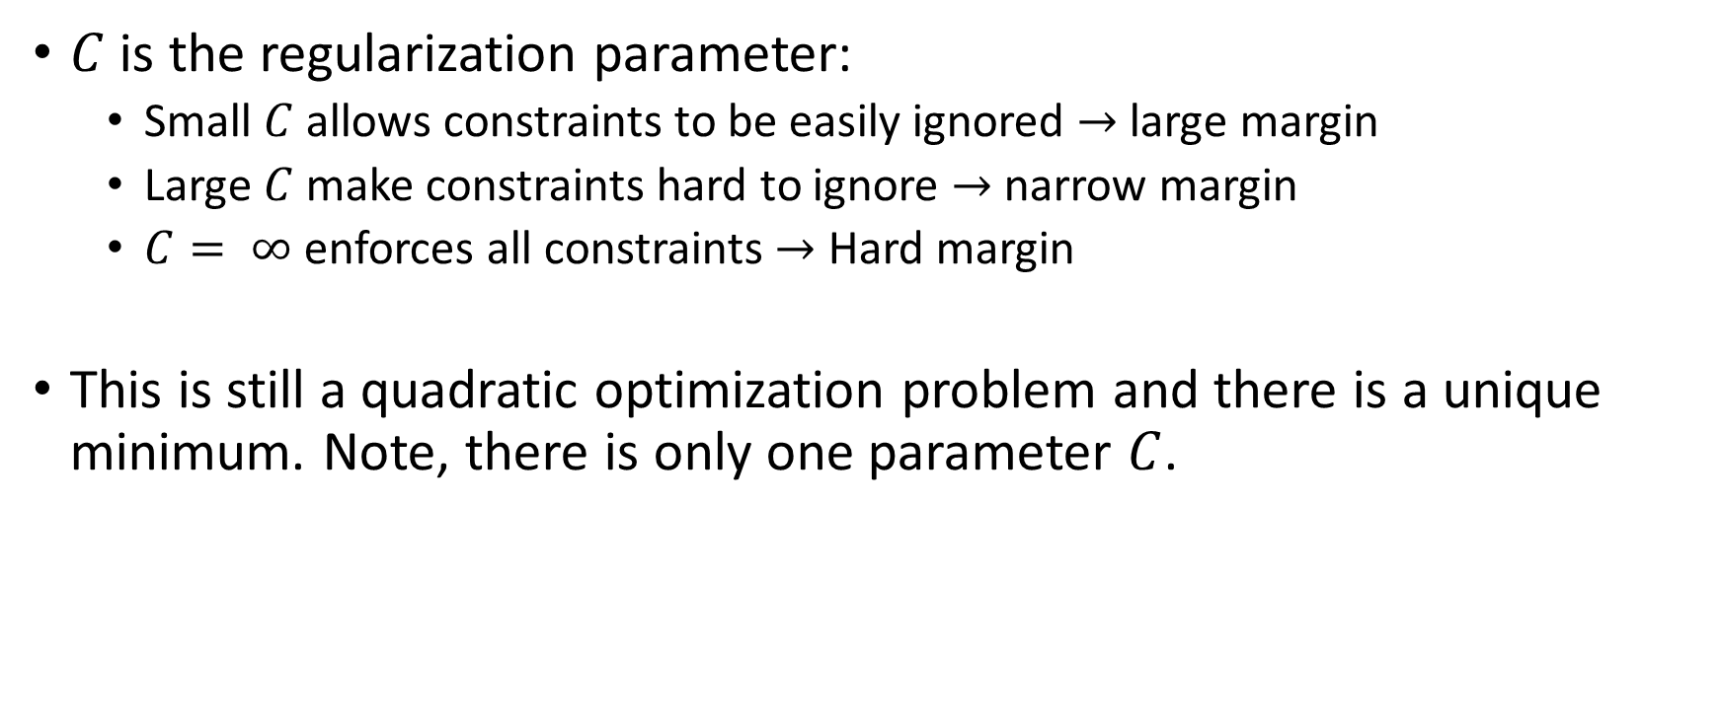
Soft Margin solution
$C$ is the regularization parameter:
Small $C$ allows constraints to be easily ignored $→$ large margin
Large $C$ make constraints hard to ignore $→$ narrow margin
$C= ∞$ enforces all constraints $→$ Hard margin
This is still a quadratic optimization problem and there is a unique minimum. Note, there is only one parameter $C$.

Slide 32
Tip
If your SVM model is overfitting, you can try regularizing it by reducing C.
Unlike Logistic Regression classifiers, SVM classifiers do not output probabilities for each class.

Slide 33
Nonlinear SVM Classification

Slide 34
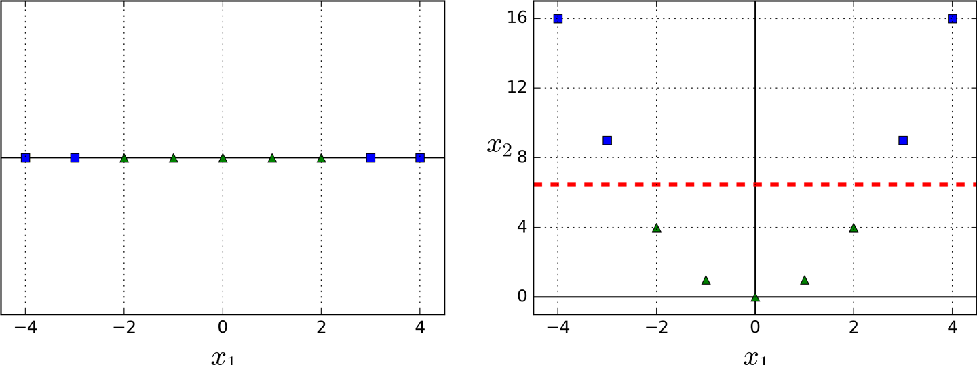
Example

Slide 35
Kernel Trick
Adding polynomial features is inefficient.
Given a constrained optimization problem, known as the primal problem, it is possible to express a different but closely related problem, called its dual problem.
The solution to the dual problem typically gives a lower bound to the solution of the primal problem, but under some conditions it can even have the same solutions as the primal problem.
the SVM problem meets these conditions, so the solution to dual problem is also a solution for primal problem.
Kernel trick, is defining a dual problem, which its solution is the same as feature transformation.

Slide 36
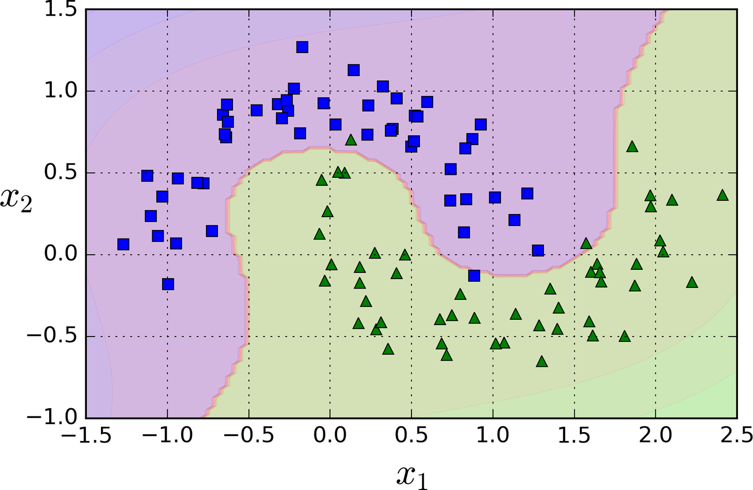
Example

Slide 37
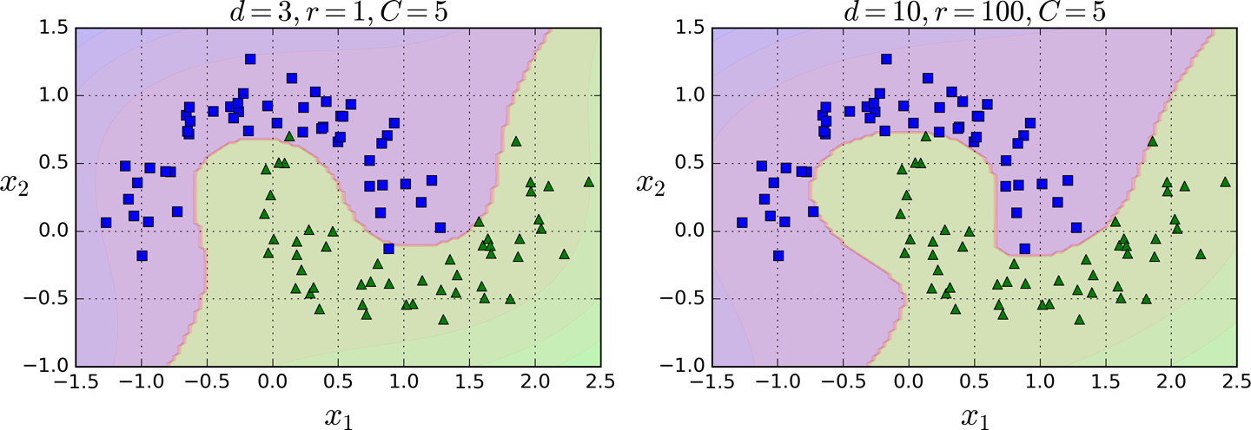
Example

Slide 38
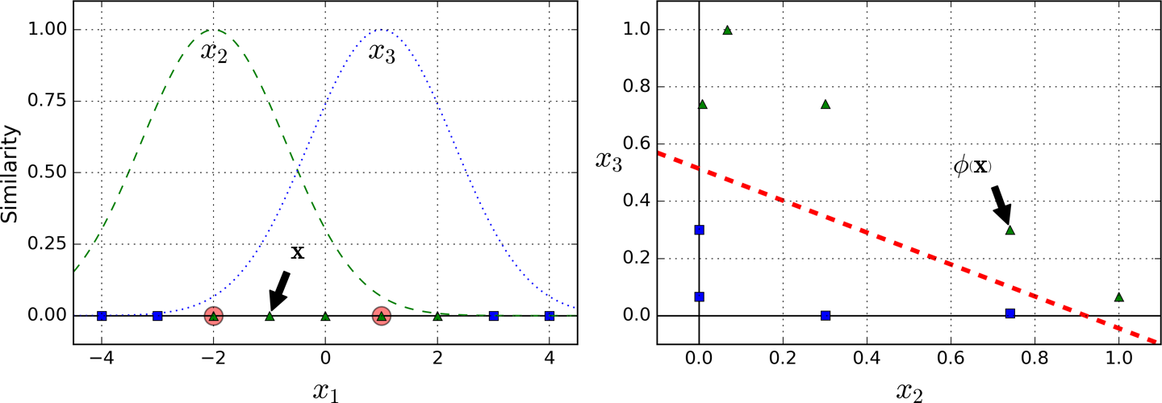

Similarity Features
Notes:
Another technique to address nonlinear problems is to use similarity function, that basically measures how much each instance resembles a particular landmark.
So let take this simple one dimensional dataset. In this example, we can consider two landmarks, like –2 and 1. One way that we can define the similarity is to take consider geometric distance. If a new point is geometrically close to a landmark, there is a higher chance to have the same label. As the points get further and further, it will be considered less similar to the landmark.
So, we can expect a bell shape like these two lines in the left plot.
The Gaussian Radial Basis Function can be used to create the bell shape you can see here.
In this function l is a landmark and x is a new instance.
Gamma is a parameter that controls how flat or tall the bell shape can get.
Now we are ready to compute the new features. For example, let’s look at the instance x1 = –1: it is located at a distance of 1 from the first landmark, and 2 from the second landmark.
Now we are dropping the original feature and replace it with new features, which in this case is x_2 and x_3. Assuming a value of gamma to be something line 0.3,
Therefore its new features are x2 = exp (–0.3 × 1^2) ≈ 0.74 and x3 = exp (–0.3 × 2^2) ≈ 0.30. The plot on the right shows the transformed dataset (dropping the original features). As you can see, it is now linearly separable.
You may wonder how to select the landmarks. The simplest approach is to create a landmark at the location of each and every instance in the dataset. This creates many dimensions and thus increases the chances that the transformed training set will be linearly separable.

Slide 39
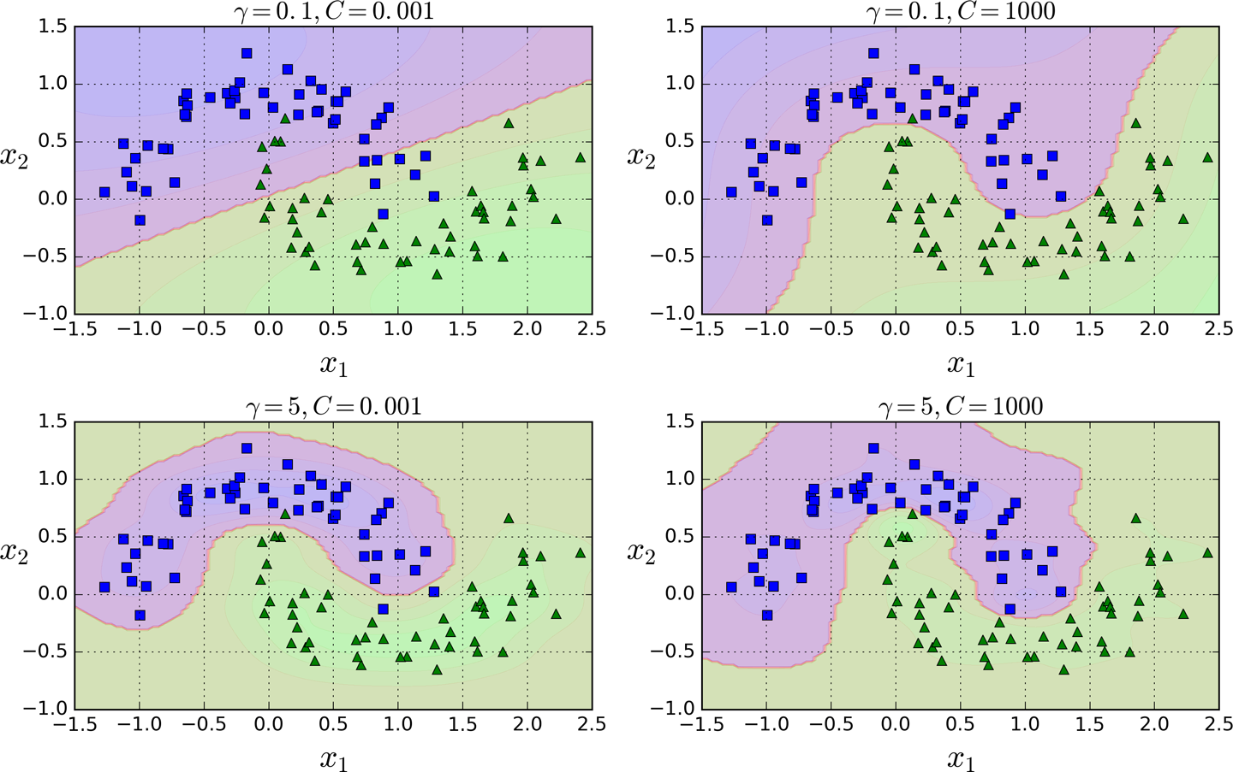
Gaussian RBF Kernel

Slide 40
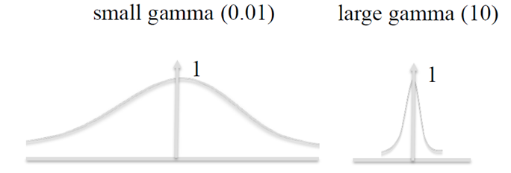
Gamma

Slide 41
Tip
With so many kernels to choose from, how can you decide which one to use?
As a rule of thumb, you should always try the linear kernel first, especially if the training set is very large or if it has plenty of features.
If the training set is not too large, you should try the Gaussian RBF kernel as well.
Then if you have spare time and computing power, you can also experiment with a few other kernels using cross-validation and grid search, especially if there are kernels specialized for your training set’s data structure.

Slide 42
Computational Complexity
The LinearSVC class is based on the liblinear library, which implements an optimized algorithm for linear SVMs.
It does not support the kernel trick, but it scales almost linearly with the number of training instances and the number of features: its training time complexity is roughly O(m × n).
The SVC class is based on the libsvm library, which implements an algorithm that supports the kernel trick.
The training time complexity is usually between O(m2 × n) and O(m3 × n).
LinearSVC is much faster than SVC(kernel="linear")

Slide 43
SVM Regression

Slide 44
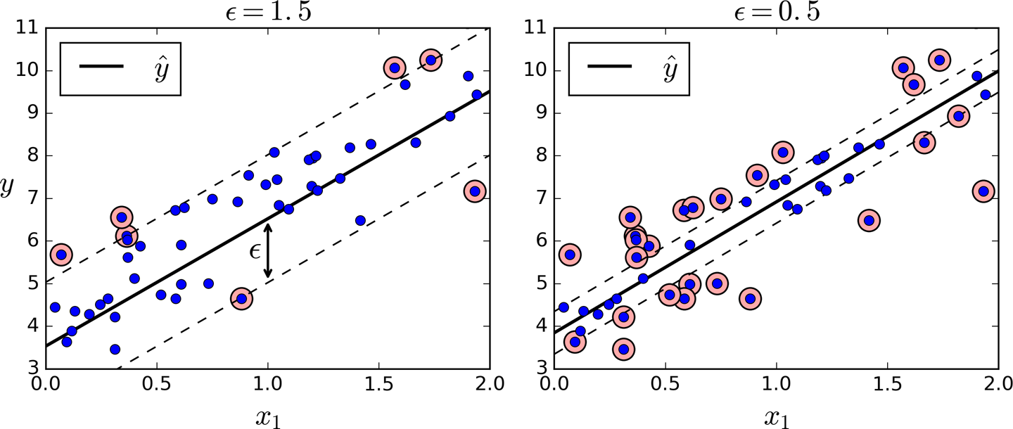
Objective
SVM Regression tries to fit as many instances as possible on the street while limiting margin violations

Slide 45
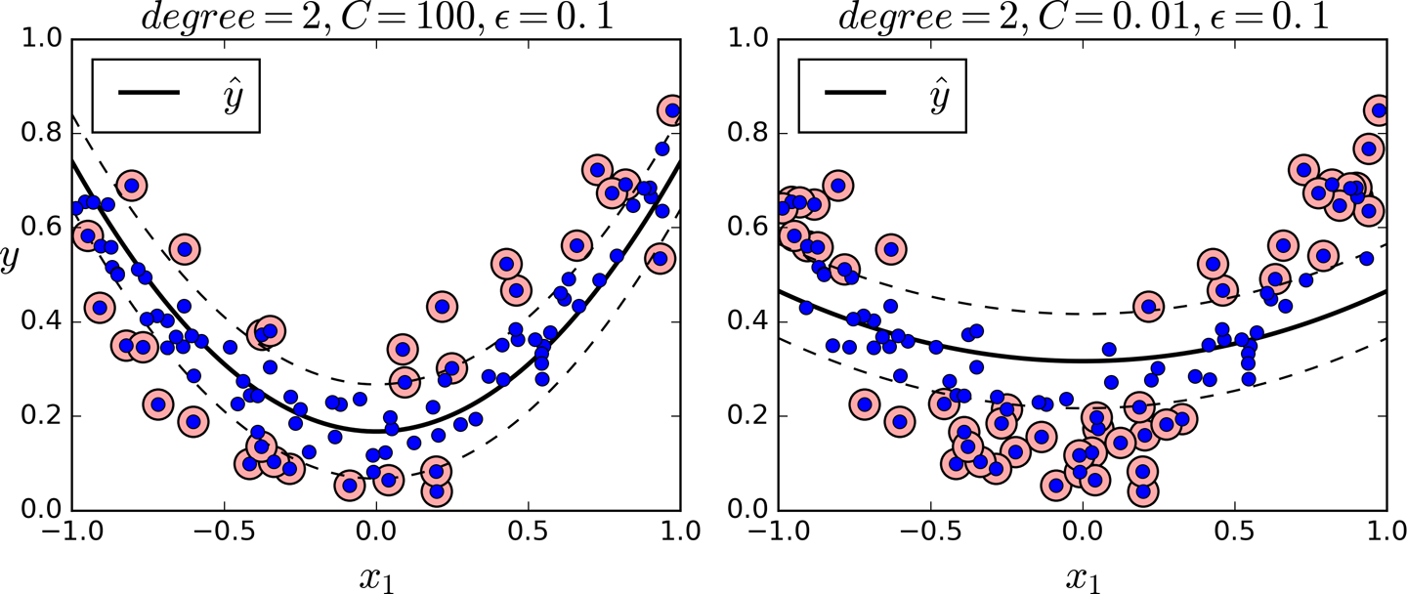
Nonlinear Regression

